Slide 1


Behavioral Health in the RHC Setting: A Nine Year Perspective

Slide 2

Agenda
I. Basic encounters and the Co-occuring Issues Dimension
II. The Billing Dimension
III. Real Integration in spite of Complexity
Notes:
2

Slide 3

Integrating Mental Health into RHCs
Notes:
3

Slide 4

R- Relationships!!!
U- Understanding
R- Reimbursement considerations
A- Adapt...constantly
L- Love your Location (as a provider)
Notes:
4

Slide 5
Mental Health Providers
Notes:
5

Slide 6
Mental Health Visits – Per Chapter 13
Notes:
6

Slide 7
Mental Health Visits – Per Chapter 13 (p.2)
Notes:
7

Slide 8
Psychiatric Codes for Behavioral Health Services
Notes:
8

Slide 9
E & M Codes
Notes:
9

Slide 10
Assessment and Intervention Codes
Notes:
10

Slide 11
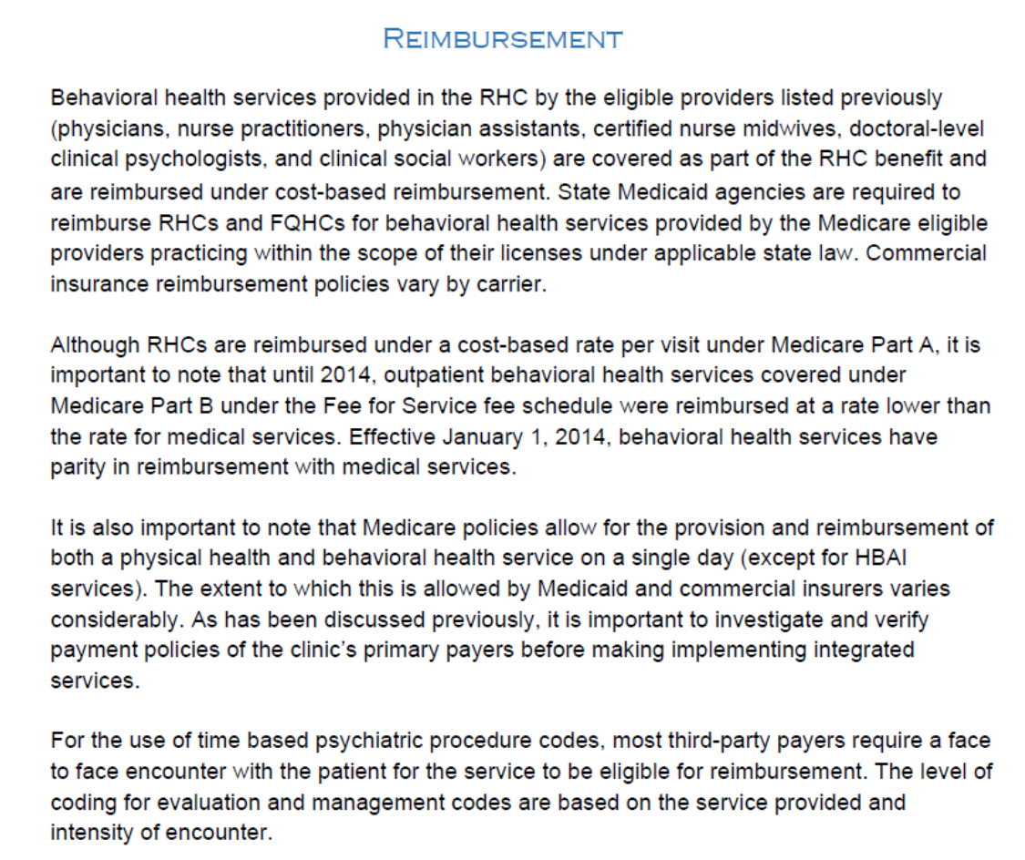
Notes:
11

Slide 12

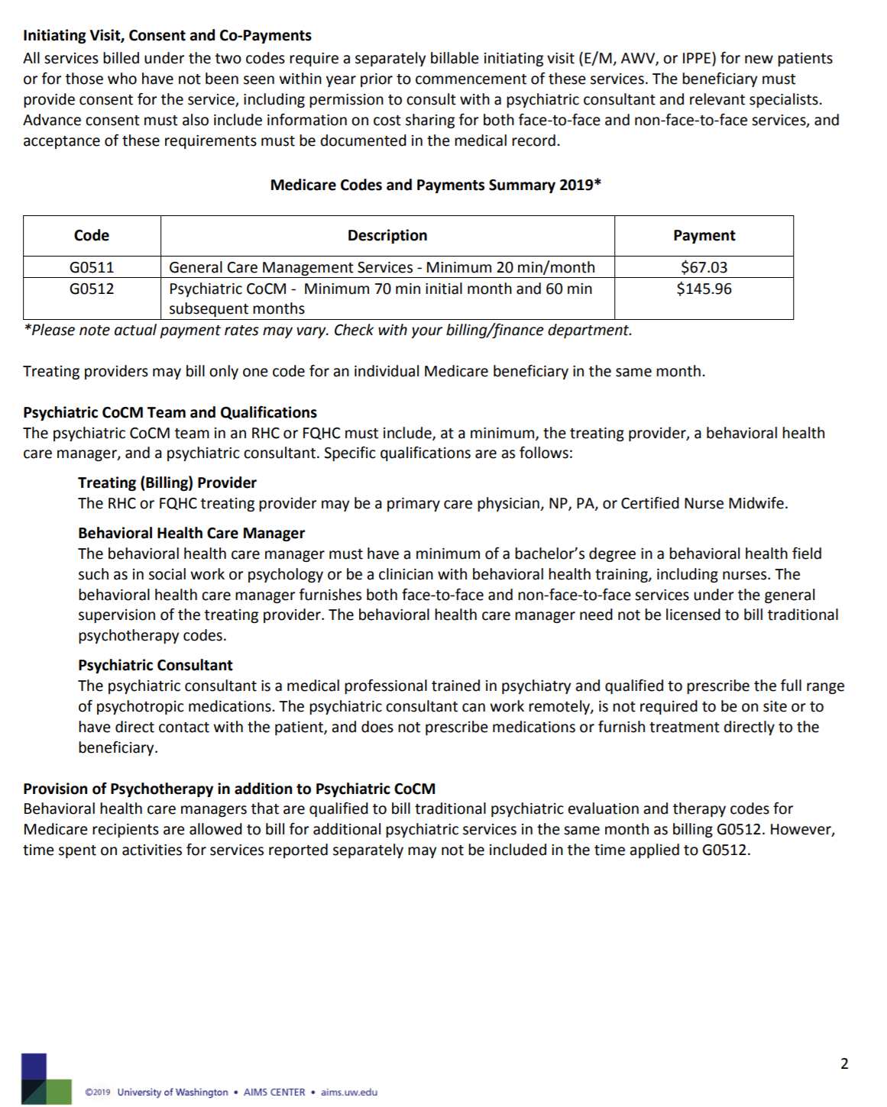

Slide 13

Notes:
13

