Slide 1
RHC Cost Report Planning (Year-End)

Slide 2
RHC Cost Report Planning (Year-End) 12/31 Cost Reports are Due 5/31
Step | Description
1 | If you would like us to prepare your cost report, please let us know.
2 | RHC Cost Report and HIPAA Agreements are currently being sent out. (If you don’t receive one by 11/20, please reach out to me.)
3 | Return signed RHC Cost Report and HIPAA Agreements, along with retainer to HBS.

Slide 3
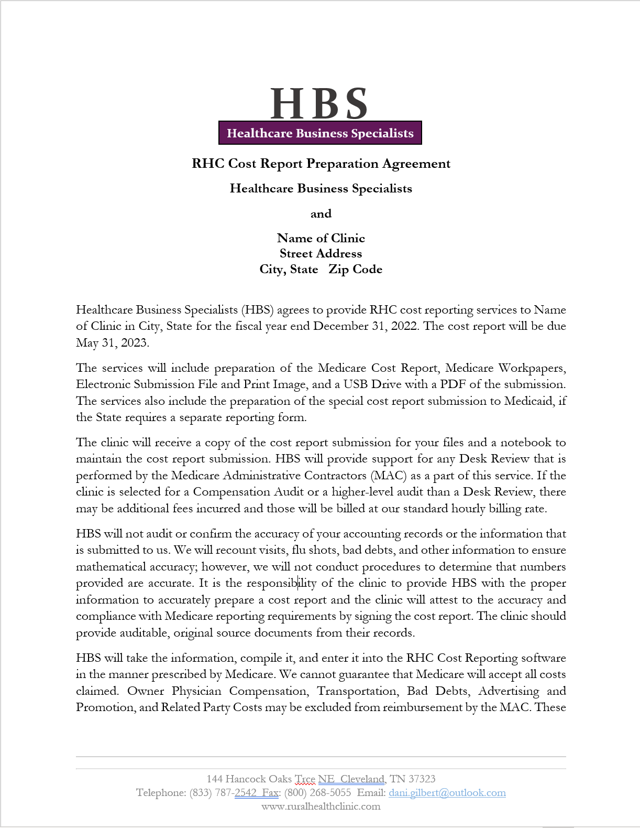
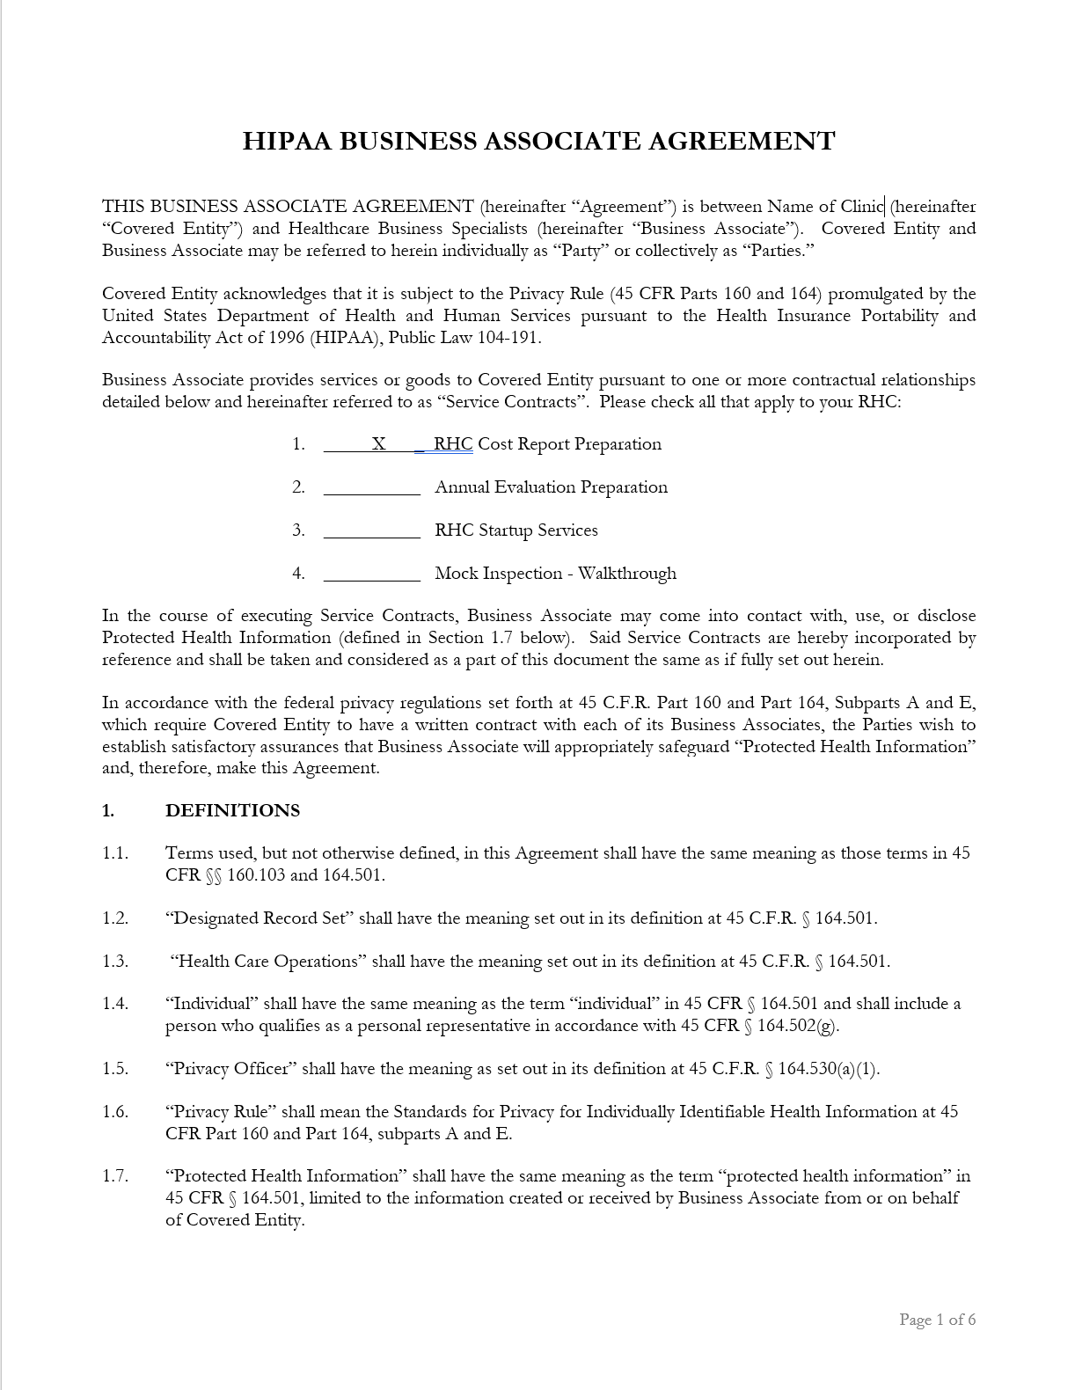
RHC Cost Report and HIPAA Agreements

Slide 4
RHC Cost Report Planning (Year-End) 12/31 Cost Reports are Due 5/31
Step | Description
1 | If you would like us to prepare your cost report, please let us know.
2 | RHC Cost Report and HIPAA Agreements are currently being sent out. (If you don’t receive one by 11/20, please reach out to me.)
3 | Return signed RHC Cost Report and HIPAA Agreements, along with retainer to HBS.
4 | Work on setting up access to the IDM System (instructions to follow).

Slide 5
Identity Management (IDM) System
CMS created the IDM System to provide providers with a means to request and obtain a single User ID, which they can use to access one or more CMS applications.
The IDM System provides the means for users to be approved to access many other CMS systems and applications. IDM governs access to CMS systems by managing the creation of user IDs and passwords, setting up multi-factor authentication (MFA), and the assignment of roles within CMS applications.

Slide 6
Identity Management (IDM) System Learning Objectives
How to Create a New User Account
IDM Self Service Dashboard (Overview)
How to Request a Role for a New Application
How to Add Attributes to an Existing Role
How to View and Cancel Role Requests

Slide 7
Identity Management (IDM) System How to Create a New User Account
Navigate to https://home.idm.cms.gov/.
Click the New User Registration button.

Slide 8
Identity Management (IDM) System How to Create a New User Account
Enter the requested information (i.e., Name, Date of Birth, E-mail Address, etc.)
Make sure the you enter an exact match in the ‘E-mail Address’ and ‘Confirm E-mail Address’ fields.
Click the Terms & Conditions button. Read the IDM terms and conditions then click the Close Terms & Conditions button.
Click the checkbox to acknowledge agreement with the terms and conditions, then click the Next button.

Slide 9
Identity Management (IDM) System How to Create a New User Account
Enter the Home Address, City, State, Zip Code and Phone Number.
Click the Next button.

Slide 10
Identity Management (IDM) System How to Create a New User Account
Enter the desired User ID, Password and Confirm Password.
The Password and Confirm Password must match.
Select a Security Question from the list.
Type the security question answer into the Answer dialog box.
Click the Submit button to submit the account registration request. The system will display a message that indicates the account was successfully created.
Click the Return button.

Slide 11
Identity Management (IDM) System IDM Self Service Dashboard (Overview)
The IDM Self Service Dashboard provides access to functions that allow users to manage their user profile, request new applications, and manage roles for applications to which they have been granted access.

Slide 12
Identity Management (IDM) System How to Request a Role for a New Application
Click the Role Request button.
Select an application (PS&R/STAR). The Select a Role menu appears after an application is selected.
You will want to select either ‘PS&R Security Official’ or ‘PS&R User’, depending on if someone from your clinic is already set up with access.
Select a role. The Remote Identity Proofing (RIDP) terms and conditions appear after role is selected.

Slide 13
Identity Management (IDM) System How to Request a Role for a New Application
Review the RIDP terms and conditions, check the “I agree to the terms and conditions” selection box, then clinic the Next button.
Complete the Identity Verification form and click the Next button.
Answer the proofing questions and click the Verify button.
Select the required attributes from the Attribute menu.
Review the role request information and click the Review Request button. The Reason for Request dialog box appears.
Enter a justification and click the Submit Role Request button. The Role Request window displays a Request ID and a message which states that the request was successfully submitted to an approver for action.

Slide 14
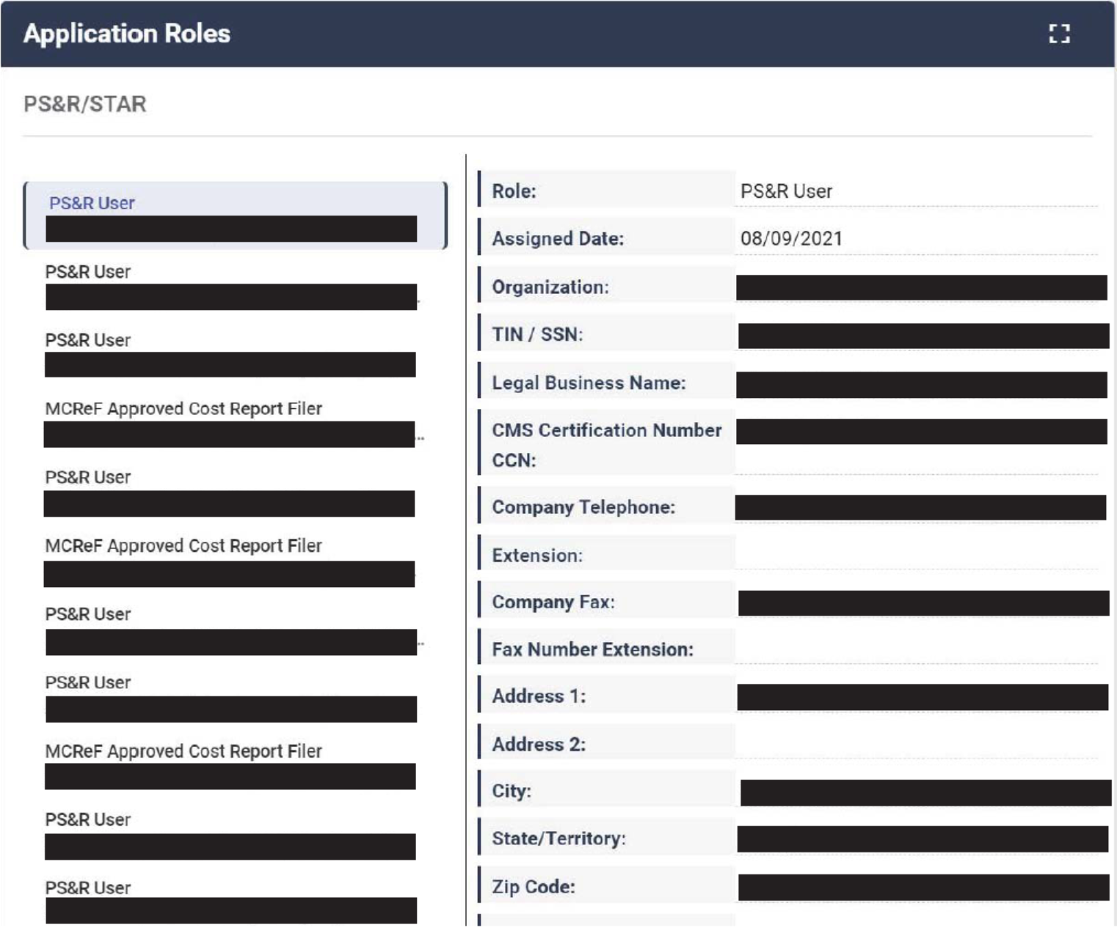
Identity Management (IDM) System How to Add Attributes to an Existing Role
Click the Manage My Roles button.
Click the View Details button.

Slide 15
Identity Management (IDM) System How to Add Attributes to an Existing Role
Click the Modify Role button. The Edit Role Details window appears. This window contains fields that are similar to those used during the initial role request, but it only permits the user to modify role attributes.
Add one or more role attributes.
Enter a justification statement and click the Submit Changes button.

Slide 16
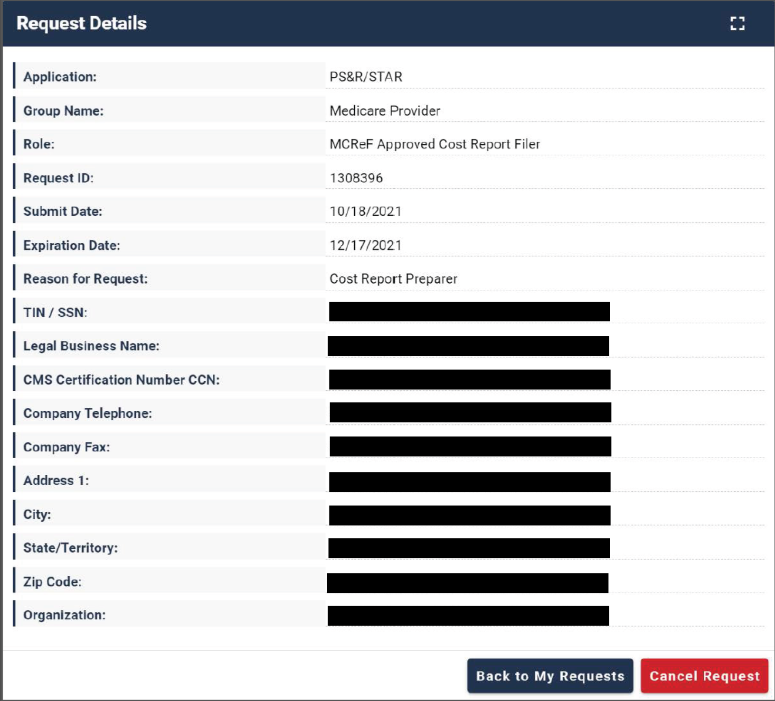
Identity Management (IDM) System How to View and Cancel Role Requests
Click the My Requests button.
Click the View Details button.
Click the Cancel Request button for the role request that will be cancelled.
Click the Cancel Role Request button.

Slide 17
Provider Statistical & Reimbursement (PS&R) System
Providers that file cost reports are required to register for the PS&R system through Individuals Authorized Access to the Centers for Medicare & Medicaid Services (CMS) Computer Services (IDM) to obtain the PS&R reports. The PS&R Redesign will be utilized for all cost reports with fiscal years ending January 31, 2009 and later. These cost reports will be both filed and settled using PS&R Redesign.
An approved PS&R User can order reports.
NOTE: For those clinics who plan on pulling their own PS&R reports, you will want to make sure that the Service Period is broken down into the following:
Period 1: 1/1/2021 – 3/31/2021 (RHC Capped Rate: $87.52)
Period 2: 4/1/2021 – 12/31/2021 (RHC Capped Rate: $100.00)

Slide 18
RHC Cost Report Planning (Year-End) 12/31 Cost Reports are Due 5/31
Step | Description
1 | If you would like us to prepare your cost report, please let us know.
2 | RHC Cost Report and HIPAA Agreements are currently being sent out. (If you don’t receive one by 11/20, please reach out to me.)
3 | Return signed RHC Cost Report and HIPAA Agreements, along with retainer to HBS.
4 | Work on setting up access to the IDM System (instructions to follow).
5 | Receive RHC Cost Report checklist from HBS.

Slide 19
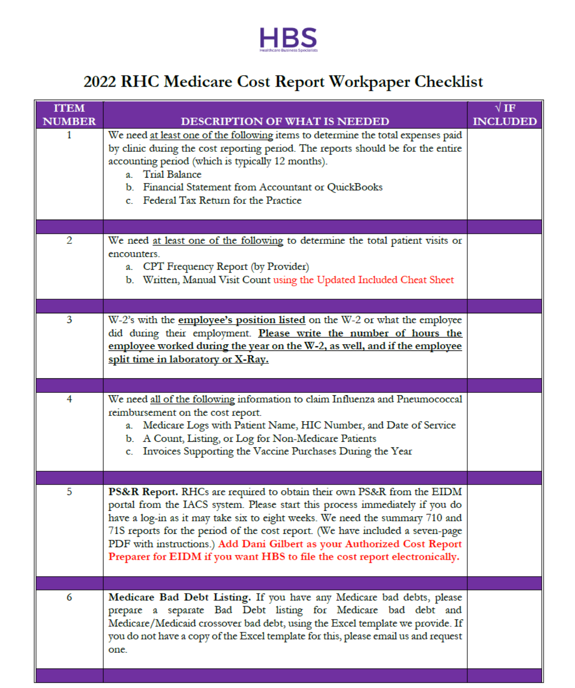
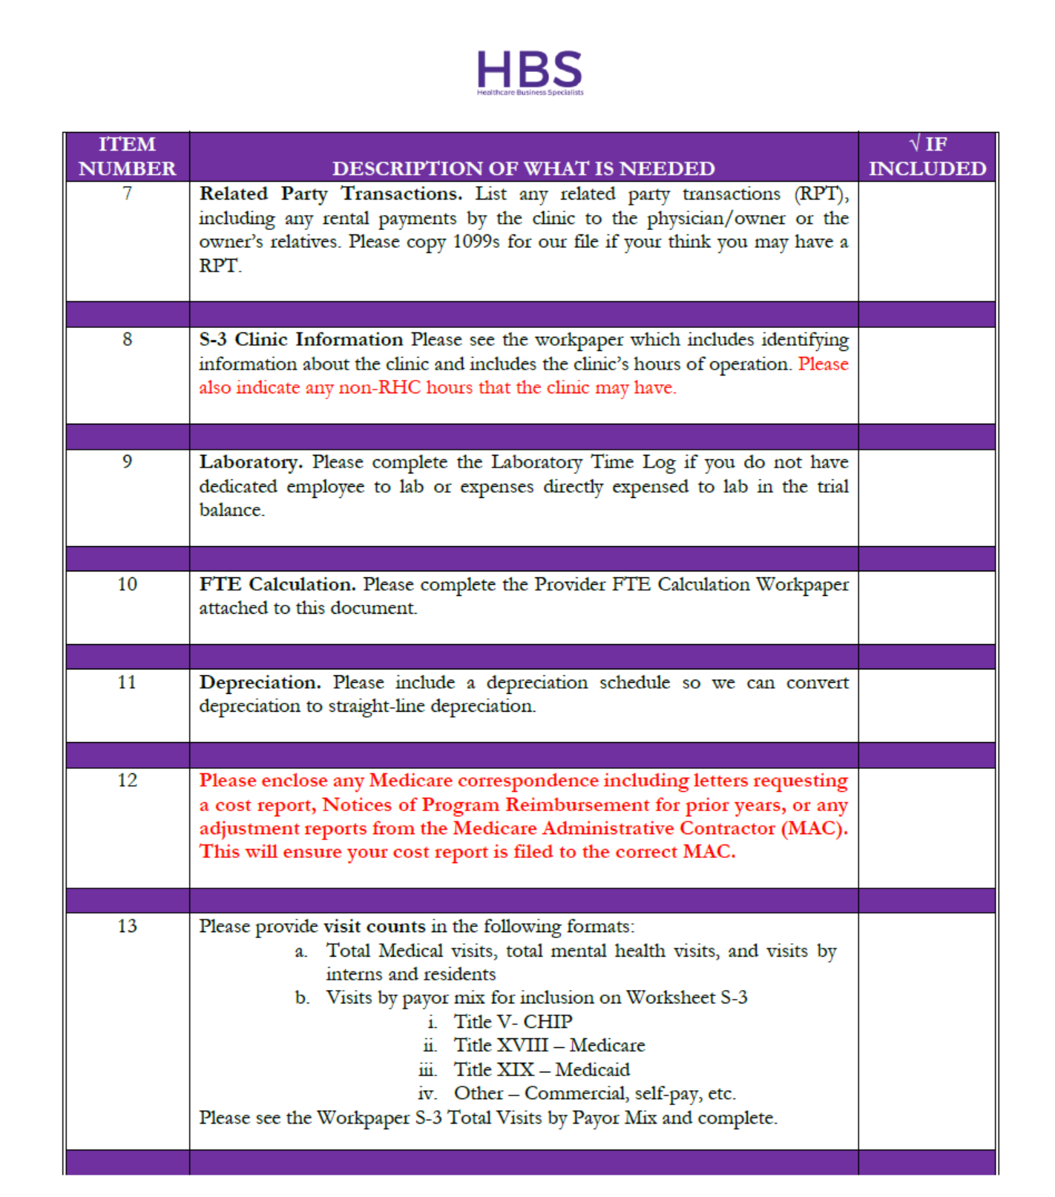
RHC Cost Report Checklist

Slide 20
RHC Cost Report Checklist

Slide 21
RHC Cost Report Planning (Year-End) 12/31 Cost Reports are Due 5/31
Step | Description
1 | If you would like us to prepare your cost report, please let us know.
2 | RHC Cost Report and HIPAA Agreements are currently being sent out. (If you don’t receive one by 11/20, please reach out to me.)
3 | Return signed RHC Cost Report and HIPAA Agreements, along with retainer to HBS.
4 | Work on setting up access to the IDM System (instructions to follow).
5 | Receive RHC Cost Report checklist from HBS.
6 | Obtain & upload information to Client Portal as early as possible. (Let me know if you do not currently have access to your portal.)

Slide 22
Client Portal (Canopy)

Slide 23
RHC Cost Report Planning (Year-End) 12/31 Cost Reports are Due 5/31
Step | Description
1 | If you would like us to prepare your cost report, please let us know.
2 | RHC Cost Report and HIPAA Agreements are currently being sent out. (If you don’t receive one by 11/20, please reach out to me.)
3 | Return signed RHC Cost Report and HIPAA Agreements, along with retainer to HBS.
4 | Work on setting up access to the IDM System (instructions to follow).
5 | Receive RHC Cost Report checklist from HBS.
6 | Obtain & upload information to Client Portal as early as possible. (Let me know if you do not currently have access to your portal.)
7 | HBS will prepare the RHC Cost Report and submit electronically, upon client approval.

Slide 24
Contact Information
Dani Gilbert, CPA, CRHCP
RHC Consultant
Healthcare Business Specialists
144 Hancock Oaks Trce NE
Cleveland, Tennessee 37323
Phone: (833) 787-2542 ext. 1
dani.gilbert@outlook.com
www.ruralhealthclinic.com

